Slide 1
Deep dive into Fourier transforms
Tom Jhou

Slide 2
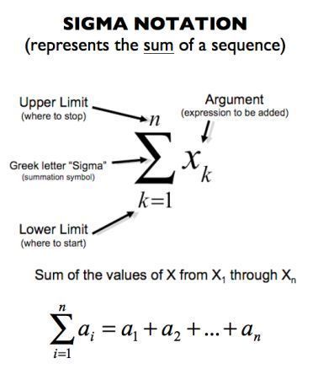
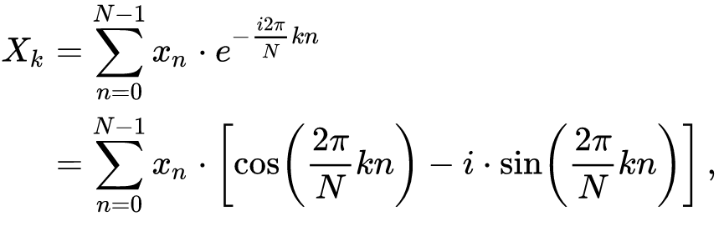
What is inside the FFT “magic box”?
Surprisingly simple formula:
N = number of samples.
x_{n} = list of waveform voltages n = 0, 1, 2, … N-1
X_{k} = list of frequency values k = 0, 1, 2, … N-1

Slide 3
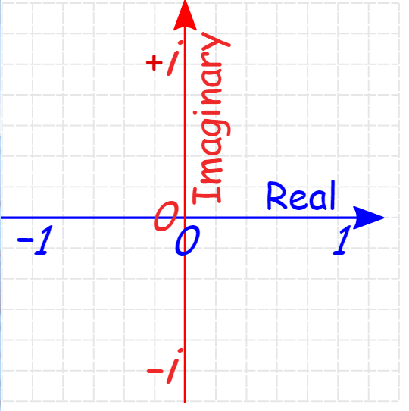
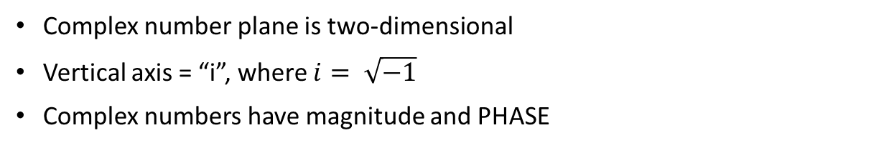
First, a refresher on complex numbers
Complex number plane is two-dimensional
Vertical axis = “i”, where $i= \sqrt{−1}$
Complex numbers have magnitude and PHASE
2+5i
A = 2 + 5i
Real(A) = 2
Imag(A) = 5
Abs(A) = sqrt(2*2 + 5*5)
= sqrt(29)
= 5.39
Notes:
The function is easy to call, but you have to pay careful attention to the details of the frequencies that come out.

Slide 4
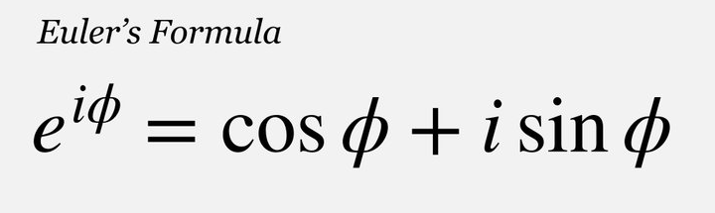
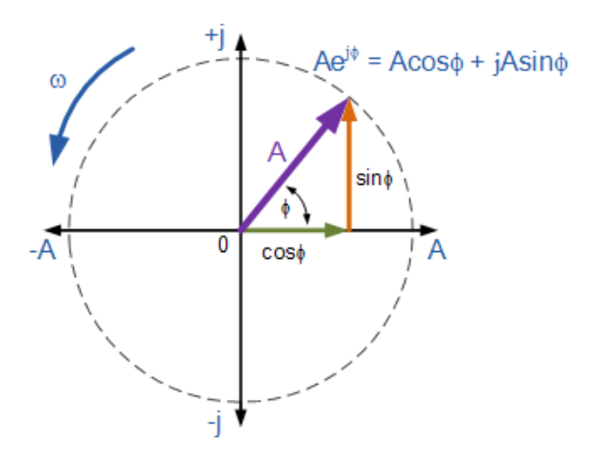
Euler’s formula:

Slide 5

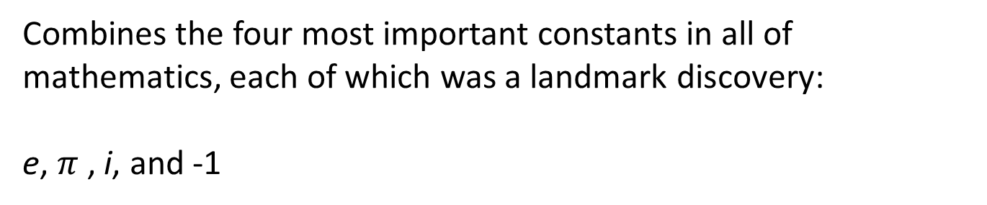
Euler’s identity:
$$e^{iπ}=−1$$
Combines the four most important constants in all of mathematics, each of which was a landmark discovery:
e, $π$, i, and -1

Slide 6
Compare sine to cosine wave.
Magnitude is same, but switches from real to imaginary
Imaginary / real components determine PHASE of sinusoid
FFT, real
FFT, imaginary
Notes:
The function is easy to call, but you have to pay careful attention to the details of the frequencies that come out.

Slide 7
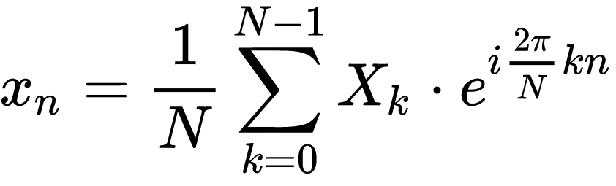
Transform can be inverted …
Fourier transform:
Inverse Fourier transform:

Slide 8
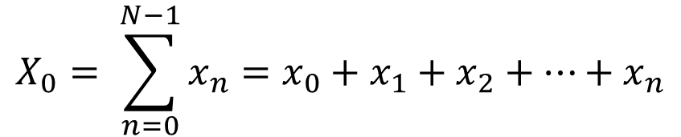
Work this out one term at a time …
The very first frequency component is simply the sum of input values.
$$X_{0}= \sum_{n=0}^{N−1}{x_{n}=x_{0}+x_{1}+x_{2}+…+x_{n}}$$

Slide 9
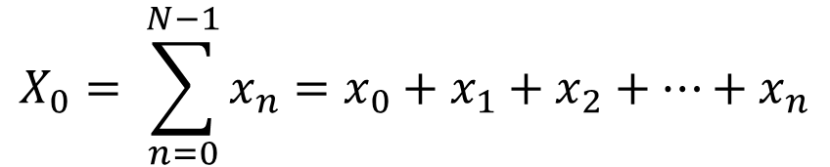

Can rewrite as matrix multiplication
$$X_{0}= \sum_{n=0}^{N−1}{x_{n}=x_{0}+x_{1}+x_{2}+…+x_{n}}$$
$$X_{0}=\left[\begin{matrix}1 & 1 & \begin{matrix}1 & … & 1\end{matrix}\end{matrix}\right]\left[\begin{matrix}\begin{matrix}x_{0} \\ x_{1}\end{matrix} \\ \begin{matrix}x_{2} \\ \begin{matrix}⋮ \\ x_{N−1}\end{matrix}\end{matrix}\end{matrix}\right]$$

Slide 10
Next frequency term…
$$X_{1}=x_{0}+x_{1}e^{−\frac{i2π}{N}}+x_{2}e^{−\frac{i4π}{N}}+…+x_{n}e^{−\frac{i2(N−1)π}{N}}$$

Slide 11
Continuing along …
$$X_{1}=x_{0}+x_{1}e^{−\frac{i2π}{N}}+x_{2}e^{−\frac{i4π}{N}}+…+x_{n}e^{−\frac{i2(N−1)π}{N}}$$
“Real” component:
$${Re(X}_{1})=x_{0}+x_{1}cos\left(\frac{2πn}{N}\right)+x_{2}cos\left(\frac{4πn}{N}\right)+…+x_{n}cos\left(\frac{2π(N−1)}{N}\right)$$
“Imaginary” component:
$${Imag(X}_{1})=x_{0}−x_{1}sin\left(\frac{2πn}{N}\right)−x_{2}sin\left(\frac{4πn}{N}\right)−…−x_{n}sin\left(\frac{2π(N−1)}{N}\right)$$

Slide 12
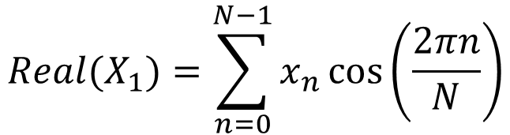
Real component with N = 100
$${Real(X}_{1})=\sum_{n=0}^{N−1}{x_{n}}\cos\left(\frac{2πn}{N}\right)$$
$=x_{0}+x_{1}cos\left(\frac{2π}{100}\right)$ $+x_{2}cos\left(\frac{4π}{100}\right)+x_{3}cos$ $\left(\frac{6π}{100}\right)$ … $x_{99}\left(\frac{198π}{100}\right)$
Sine
Cosine

Slide 13
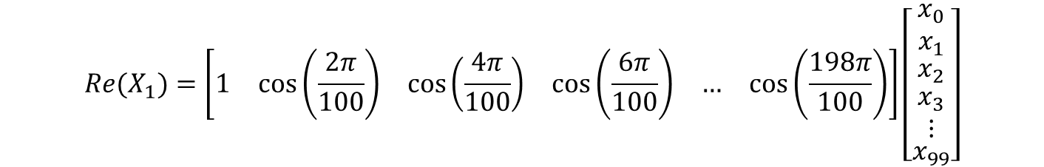
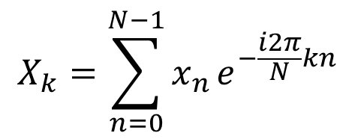
This is yet another dot product
$$X_{k}=\sum_{n=0}^{N−1}{x_{n}}e^{−\frac{i2π}{N}kn}$$
$${Re(X}_{1})=\left[\begin{matrix}1 & cos\left(\frac{2π}{100}\right) & \begin{matrix}cos\left(\frac{4π}{100}\right) & \begin{matrix}cos\left(\frac{6π}{100}\right) & …\end{matrix} & cos\left(\frac{198π}{100}\right)\end{matrix}\end{matrix}\right]\left[\begin{matrix}\begin{matrix}x_{0} \\ x_{1}\end{matrix} \\ \begin{matrix}x_{2} \\ \begin{matrix}\begin{matrix}x_{3} \\ ⋮\end{matrix} \\ x_{99}\end{matrix}\end{matrix}\end{matrix}\right]$$

Slide 14
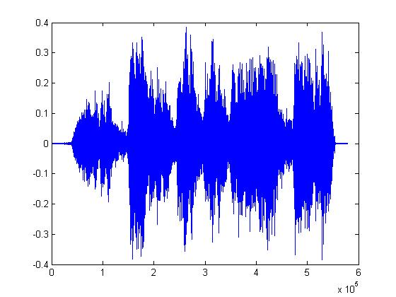
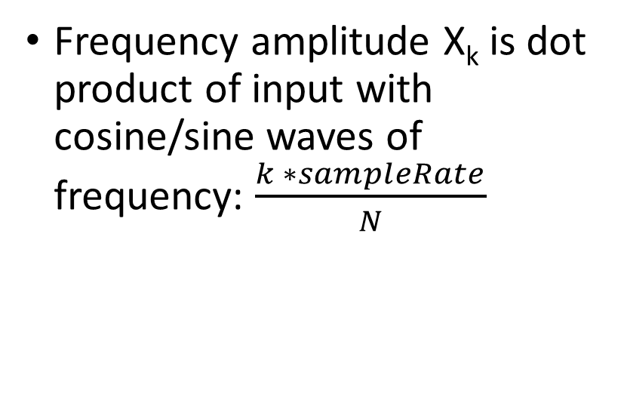
Fourier transform
frequency = 0
f = sampleRate/n
2f
Frequency amplitude X_{k} is dot product of input with cosine/sine waves of frequency: $\frac{k ∗sampleRate}{N}$
3f
4f
5f
6f
7f
8f
9f

Slide 15
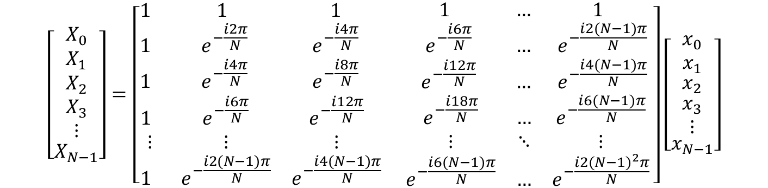
A collection of dot products = matrix multiplication
$$\left[\begin{matrix}\begin{matrix}X_{0} \\ X_{1}\end{matrix} \\ \begin{matrix}X_{2} \\ \begin{matrix}\begin{matrix}X_{3} \\ ⋮\end{matrix} \\ X_{N−1}\end{matrix}\end{matrix}\end{matrix}\right]=\left[\begin{matrix}\begin{matrix}1 & 1 & 1 \\ 1 & e^{−\frac{i2π}{N}} & e^{−\frac{i4π}{N}} \\ 1 & e^{−\frac{i4π}{N}} & e^{−\frac{i8π}{N}}\end{matrix} & \begin{matrix} 1 & … & 1 \\ e^{−\frac{i6π}{N}} & … & e^{−\frac{i2(N−1)π}{N}} \\ e^{−\frac{i12π}{N}} & … & e^{−\frac{i4(N−1)π}{N}}\end{matrix} \\ \begin{matrix}1 & e^{−\frac{i6π}{N}} & e^{−\frac{i12π}{N}} \\ ⋮ & ⋮ & ⋮ \\ 1 & e^{−\frac{i2(N−1)π}{N}} & e^{−\frac{i4(N−1)π}{N}}\end{matrix} & \begin{matrix}e^{−\frac{i18π}{N}} & … & e^{−\frac{i6(N−1)π}{N}} \\ ⋮ & ⋱ & ⋮ \\ e^{−\frac{i6(N−1)π}{N}} & … & e^{−\frac{i2{(N−1)}^{2}π}{N}}\end{matrix}\end{matrix}\right]\left[\begin{matrix}\begin{matrix}x_{0} \\ x_{1}\end{matrix} \\ \begin{matrix}x_{2} \\ \begin{matrix}\begin{matrix}x_{3} \\ ⋮\end{matrix} \\ x_{N−1}\end{matrix}\end{matrix}\end{matrix}\right]$$

Slide 16

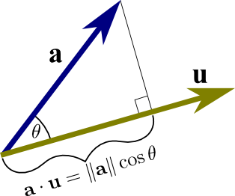
Review of geometric interpretation of dot product as projection of one vector onto another vector
Vector “a” can be projected onto “u”
Unit vector “u” has length 1.
Projection is
Notes:
Using the definition of cosine, we can “prove” the dot product for the special case where one vector lies along the x-axis.

Slide 17
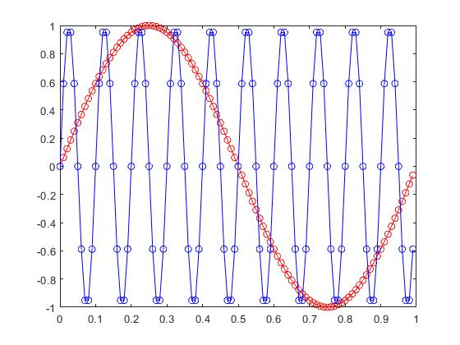
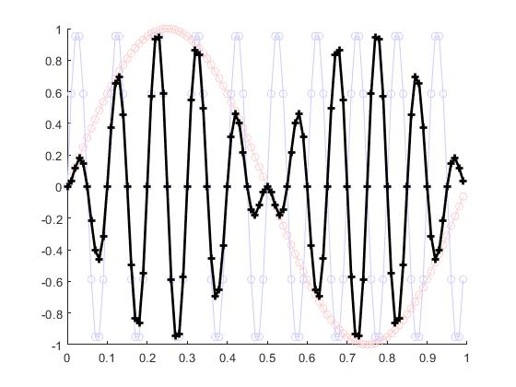
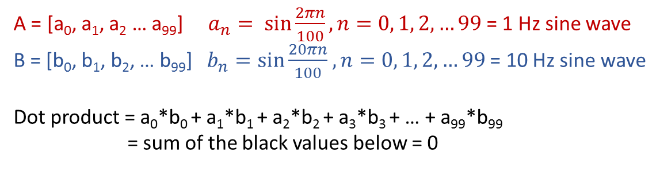
Dot product of any two rows in Fourier matrix = 0
A = [a₀, a₁, a₂ … a₉₉] $a_{n}= sin{\frac{2πn}{100}, n=0, 1, 2, …99}$= 1 Hz sine wave
B = [b₀, b₁, b₂, … b₉₉] $b_{n}=\sin{\frac{20πn}{100}}$ $, n=0, 1, 2, …99$ = 10 Hz sine wave
Dot product = a₀*b₀ + a₁*b₁ + a₂*b₂ + a₃*b₃ + … + a₉₉*b₉₉
= sum of the black values below = 0

Slide 18
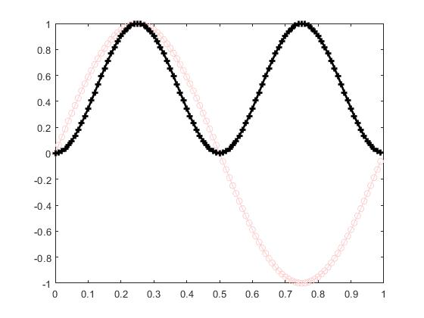
Dot product of any Fourier matrix row with itself (actually its complex conjugate) = N
Dot product = a₀² + a₁² + a₂² + a₃² + … + a₉₉²
= sum of the black values below = 50

Slide 19
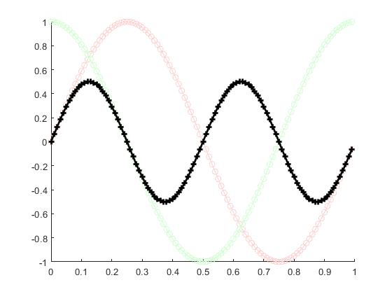
Dot product of sine and cosine is zero because they are 90 degrees out of phase.
Sum of black values = 0

Slide 20
Note:
x_{n} = list of values at times: n = 0, 1, 2, … N-1
X_{k} = list of values at frequencies: k = 0, 1, 2, … N-1
We used normalized units 0, 1, 2, …. What are the “real” units, in seconds and Hertz?

Slide 21
Time interval is reciprocal of sample rate
E.g. if sample rate = 100 Hertz, then interval between timestamps is 1/F = 0.01 sec

Slide 22

Frequency interval is 1/T, where T is duration of input vector in seconds
# of samples N = F * T.
Highest frequency is (N-1)/T = $F\left(\frac{N−1}{N}\right)$, just slightly less than the sample rate F
Nyquist frequency = F/2
Frequency = F – 1/T
← N = 100 samples →

Slide 23

For example …
List of times: $0, \frac{1}{F},\frac{2}{F},$ $\frac{3}{F},…,$ $(\frac{FT−1}{F})$ seconds
List of frequencies: $0, \frac{1}{T},\frac{2}{T},$ $\frac{3}{T},…,$ $\left(\frac{FT−1}{T}\right)Hertz$
Slightly < T
Last value at 0.99sec, not 1.00!
Slightly < F
Last value at 99Hz, not 100!
First value at t=0
Notes:
In theory, you could add one more time sample, giving 101 samples with the last sample at 1.00 seconds.
But the FFT will still stop one sample short of 100 Hz. And now T = 1.1, so that list of frequencies is a very odd set of numbers.

Slide 24
We’re not actually missing last time point. See staircase plot:
First value starts at t=0
Staircase “step” extends until t=0.01
100th value starts at t=0.99sec,
Staircase “step” extends until t=1.00sec
Notes:
In theory, you could add one more time sample, giving 101 samples with the last sample at 1.00 seconds.
But the FFT will still stop one sample short of 100 Hz. And now T = 1.1, so that list of frequencies is a very odd set of numbers.

Slide 25
Another way to look at Fourier transform
Twenty minute video …
https://www.youtube.com/watch?v=spUNpyF58BY&t=9s

Slide 26
Convolution conceptualization #3:
Make polynomial having coefficients f, g:
F(z) = f₀ + f₁x + f₂x² + f₃x³ + …
G(z) = g₀ + g₁x + g₂x² + g₃x³ + …
(We omit negative time values for now)
This is the “z” transform. Converts a list of numbers into a function of “z” having those numbers as coefficients of z⁰, z¹, z², z³, z⁴, …

Slide 27
By historical convention, we use “z” instead of “x”, but same idea:
F(z) = f₀ + f₁z + f₂z² + f₃z³ + …
G(z) = g₀ + g₁z + g₂z² + g₃z³ + …
This is the “z” transform. Converts a list of numbers into a function of “z”.

Slide 28
Multiply F(z)G(z):
F(z) = f₀ + f₁z + f₂z² + f₃z³ + …
G(z) = g₀ + g₁z + g₂z² + g₃z³ + …
Use distributive property:
(X + Y + Z + W + …)*A = XA + YA + ZA + WA + …
F(z)G(z) = f₀G(z)+ f₁zG(z) + f₂z²G(z) + f₃z³G(z) + …
= f₀(g₀ + g₁z + g₂z² + g₃z³ + …)
+ f₁z(g₀ + g₁z + g₂z² + g₃z³ + …)
+ f₂z²(g₀ + g₁z + g₂z² + g₃z³ + …)
+ f₃z³(g₀ + g₁z + g₂z² + g₃z³ + …)
+ …
Notes:
The distributive property looks a lot like the linearity property you saw a few slides ago. If you want to calculate the product of A times the sum of other numbers (X and Y), you can either add them first, then multiply by A, or you can play the divide and conquer game, and multiply the individual numbers by A, then take the sum. As with convolution, or any other linear function, you can add first, then multiply, or multiply first, then add.

Slide 29
Distribute a second time:
F(z)G(z) = f₀(g₀ + g₁z + g₂z² + g₃z³ + …)
+ f₁z(g₀ + g₁z + g₂z² + g₃z³ + …)
+ f₂z²(g₀ + g₁z + g₂z² + g₃z³ + …)
+ f₃z³(g₀ + g₁z + g₂z² + g₃z³ + …)
+ …
F(z)G(z) = f₀g₀ + f₀g₁z + f₀g₂z² + f₀g₃z³ + …
+ f₁g₀z + f₁g₁z² + f₁g₂z³ + f₁g₃z⁴ + …
+ f₂g₀z² + f₂g₁z³ + f₂g₂z⁴ + f₂g₃z⁵ + …
+ f₃g₀z³ + f₃g₁z⁴ + f₃g₂z⁵ + f₃g₃z⁶ + …
+ …
Sum of subscripts = exponent of z

Slide 30
Group by powers of z:
F(z)G(z) = f₀g₀ + …
+ (f₁g₀ + f₀g₁ )z + …
+ (f₂g₀ + f₁g₁ + f₀g₂)z² + …
+ (f₃g₀ + f₂g₁ + f₁g₂ + f₀g₃)z³ + …
+ (f₄g₀ + f₃g₁ + f₂g₂ + f₁g₃ + f₀g₄₎z⁴ + …
…
Coefficient of z^{n}
is sum of pairwise products
whose subscripts sum to n
Hmmm, that sounds like a convolution …

Slide 31
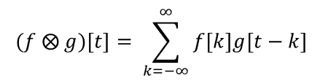
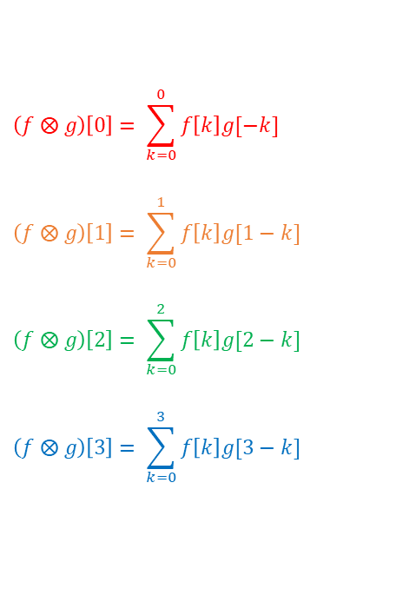
It’s the same sum we saw with convolution
$$(f ⨂ g)\left[t\right]= \sum_{k=−∞}^{∞}{f\left[k\right]g[t−k}]$$
Sum of subscripts = 0
Sum of subscripts = 2
Sum of subscripts = 1
 | g[0] | g[1] | g[2] | g[3]
f[0] | f[0]*g[0] | f[0]*g[1] | f[0]*g[2] | f[0]*g[3]
f[1] | f[1]*g[0] | f[1]*g[1] | f[1]*g[2] | f[1]*g[3]
f[2] | f[2]*g[0] | f[2]*g[1] | f[2]*g[2] | f[2]*g[3]
f[3] | f[3]*g[0] | f[3]*g[1] | f[3]*g[2] | f[3]*g[3]
$$\left(f ⨂ g\right)\left[0\right]= \sum_{k=0}^{0}{f\left[k\right]g[−k}]$$
$$\left(f ⨂ g\right)\left[1\right]= \sum_{k=0}^{1}{f\left[k\right]g[1−k}]$$
$$\left(f ⨂ g\right)\left[2\right]= \sum_{k=0}^{2}{f\left[k\right]g[2−k}]$$
$$\left(f ⨂ g\right)\left[3\right]= \sum_{k=0}^{3}{f\left[k\right]g[3−k}]$$

Slide 32
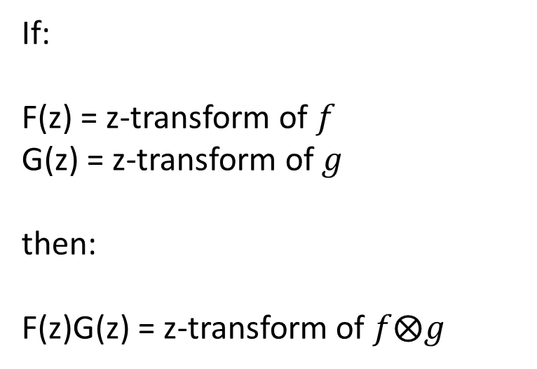
Multiplying polynomials is equivalent to convolving coefficients!
If:
F(z) = z-transform of $f$ G(z) = z-transform of $g$ then: F(z)G(z) = z-transform of $f⨂g$

Slide 33
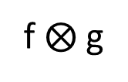
Convolution in time domain = multiplication in z-domain
Time domain
“z” domain
Z-transform
f₀, f₁, f₂, …
F(z)
g₀, g₁, g₂, …
G(z)
Convolve
Multiply
f $⨂$ g
F(z)G(z)
Z-transform
Notes:
Convolving in TIME domain is equivalent to multiplying in Z domain.
You can take two time series, f and g, and convolve them to get a third time series.
Or you can take the z-transforms of f and g, multiply them, and you’ll get something that is the z-transform of the convolved time series.

Slide 34
What is this z-transform?

Slide 35

z can be any number. What if z = 1?
F(z) = f₀ + f₁z + f₂z² + f₃z³ + …
F(1) is sum of coefficients:
$$F\left(1\right)=\sum_{n=0}^{∞}{f_{n}}$$

Slide 36

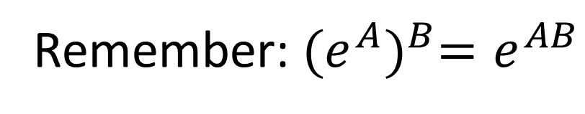
What if: $z=e^{−2πi/N}$?
Remember: ${(e^{A})}^{B}=e^{AB}$
$$F\left(z\right)=f_{0}+f_{1}z+{f_{2}z}^{2}+{f_{3}z}^{3}+…+{f_{N−1}z}^{N−1}$$
$$=f_{0}+{f_{1}e}^{\frac{−2πi}{N}}+{f_{2}(e}^{\frac{−2πi}{N}})2+{f_{3}(e}^{\frac{−2πi}{N}})3+…+f_{99}{(e^{\frac{−2πi}{N}})}^{N−1})$$
$$=f_{0}+{f_{1}e}^{\frac{−2πi}{N}}+{f_{2}e}^{\frac{−4πi}{N}}+{f_{3}e}^{\frac{−6πi}{N}}+…+{f_{N−1}e}^{\frac{−2(N−1)πi}{N}}$$
Notes:
Everywhere we see a “z”, we plug in exp(-2pi*i/N).
Raising an exponential to a second exponential just causes the exponents to multiply.

Slide 37

Euler’s identity: $e^{−2πi/N}=cos\left(\frac{2π}{N}\right)+i sin⁡(\frac{2π}{N})$
$$F\left(z\right)=f_{0}+{f_{1}e}^{\frac{−2πi}{N}}+{f_{2}e}^{\frac{−4πi}{N}}+{f_{3}e}^{\frac{−6πi}{N}}+…+{f_{99}e}^{\frac{−198πi}{N}}$$
$$Real\left[F\left(z\right)\right]=f_{0}+f_{1}cos\left(\frac{2π}{100}\right)+f_{2}cos\left(\frac{4π}{100}\right)+f_{3}cos\left(\frac{6π}{100}\right)+…+f_{99}cos\left(\frac{198π}{100}\right)$$
$$Imag\left[F\left(z\right)\right]=−f_{1}sin\left(\frac{2π}{100}\right)−f_{2}sin\left(\frac{4π}{100}\right)−f_{3}sin\left(\frac{6π}{100}\right)−…−f_{99}sin\left(\frac{198π}{100}\right)$$
Notes:
I set N = 100 arbitrarily here. Obviously, it can be anything.

Slide 38
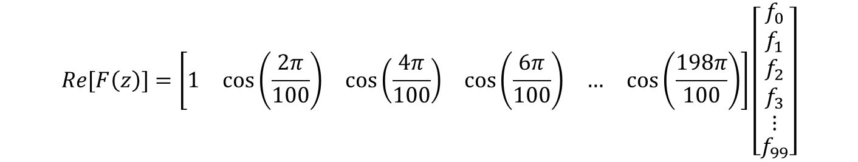
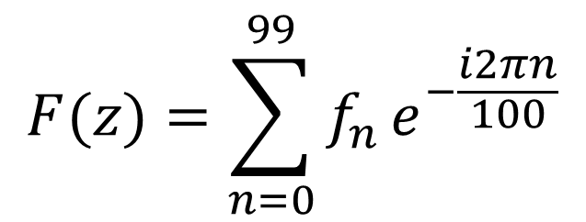
A familiar dot product
$$F(z)=\sum_{n=0}^{99}{f_{n}}e^{−\frac{i2πn}{100}}$$
$$Re[F\left(z\right)]=\left[\begin{matrix}1 & cos\left(\frac{2π}{100}\right) & \begin{matrix}cos\left(\frac{4π}{100}\right) & \begin{matrix}cos\left(\frac{6π}{100}\right) & …\end{matrix} & cos\left(\frac{198π}{100}\right)\end{matrix}\end{matrix}\right]\left[\begin{matrix}\begin{matrix}f_{0} \\ f_{1}\end{matrix} \\ \begin{matrix}f_{2} \\ \begin{matrix}\begin{matrix}f_{3} \\ ⋮\end{matrix} \\ f_{99}\end{matrix}\end{matrix}\end{matrix}\right]$$

Slide 39
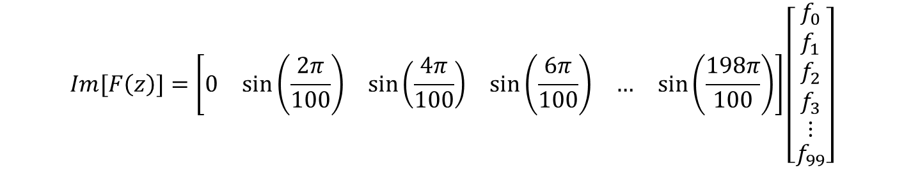
A familiar dot product
$$F(z)=\sum_{n=0}^{99}{f_{n}}e^{−\frac{i2πn}{100}}$$
$$Im[F\left(z\right)]=\left[\begin{matrix}0 & sin\left(\frac{2π}{100}\right) & \begin{matrix}sin\left(\frac{4π}{100}\right) & \begin{matrix}sin\left(\frac{6π}{100}\right) & …\end{matrix} & sin\left(\frac{198π}{100}\right)\end{matrix}\end{matrix}\right]\left[\begin{matrix}\begin{matrix}f_{0} \\ f_{1}\end{matrix} \\ \begin{matrix}f_{2} \\ \begin{matrix}\begin{matrix}f_{3} \\ ⋮\end{matrix} \\ f_{99}\end{matrix}\end{matrix}\end{matrix}\right]$$

Slide 40
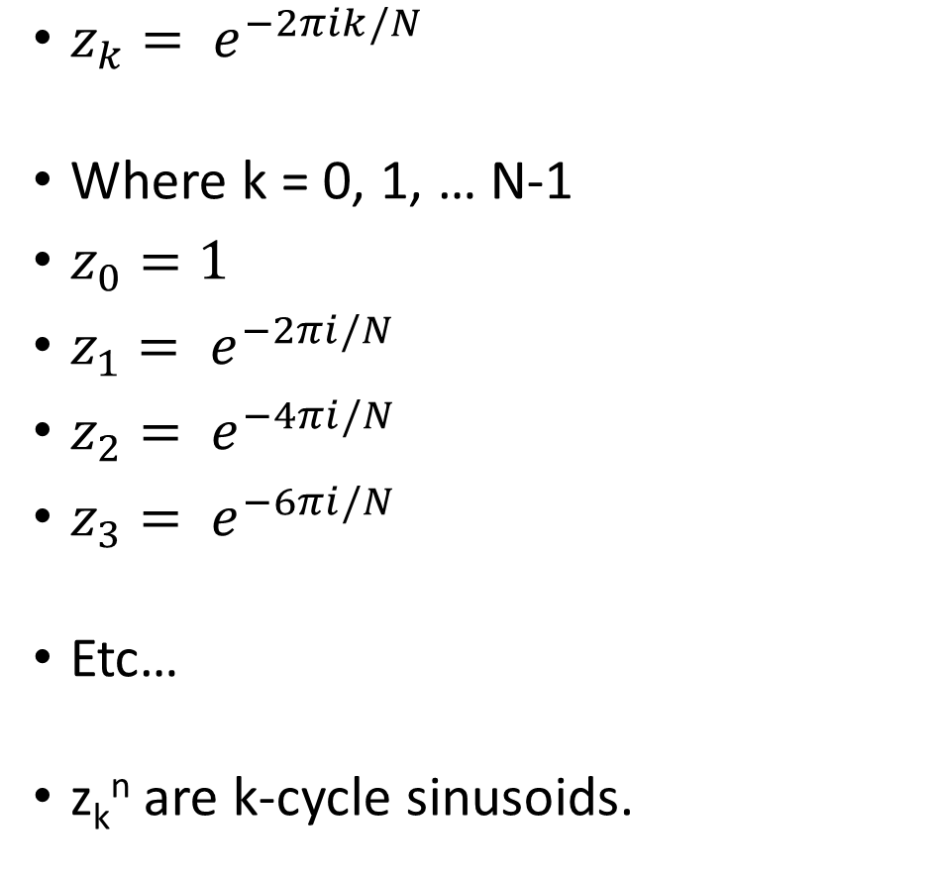
Keep going …
z₀^{n}
z₁^{n}
$z_{k}= e^{−2πik/N}$
Where k = 0, 1, … N-1
$z_{0}=1$
$z_{1}= e^{−2πi/N}$
$z_{2}= e^{−4πi/N}$
$z_{3}= e^{−6πi/N}$
Etc…
z_{k}^{n} are k-cycle sinusoids.
z₂^{n}
z₃^{n}
z₄^{n}
z₅^{n}
z₆^{n}
z₇^{n}
z₈^{n}
z₉^{n}
n = 0 to N-1

Slide 41
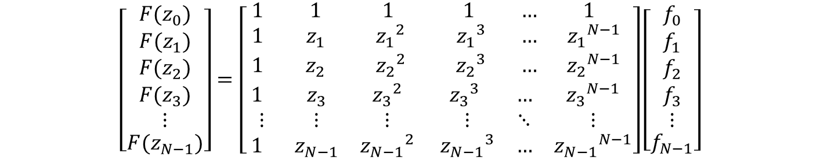
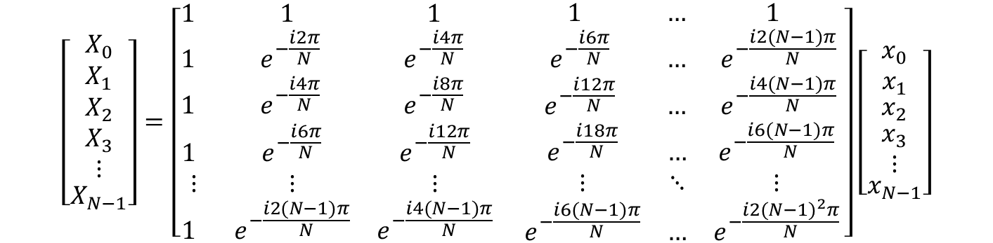
Put all these z tranforms together = Fourier!
$$\left[\begin{matrix}\begin{matrix}{F(z}_{0}) \\ {F(z}_{1})\end{matrix} \\ \begin{matrix}{F(z}_{2}) \\ \begin{matrix}\begin{matrix}{F(z}_{3}) \\ ⋮\end{matrix} \\ {F(z}_{N−1})\end{matrix}\end{matrix}\end{matrix}\right]=\left[\begin{matrix}\begin{matrix} 1 & 1 & 1 \\ 1 & z_{1} & {z_{1}}^{2} \\ 1 & z_{2} & {z_{2}}^{2}\end{matrix} & \begin{matrix} 1 & … & 1 \\ {z_{1}}^{3} & … & {z_{1}}^{N−1} \\ {z_{2}}^{3} & … & {z_{2}}^{N−1}\end{matrix} \\ \begin{matrix}1 & z_{3} & {z_{3}}^{2} \\ ⋮ & ⋮ & ⋮ \\ 1 & z_{N−1} & {z_{N−1}}^{2}\end{matrix} & \begin{matrix}{z_{3}}^{3} & … & {z_{3}}^{N−1} \\ ⋮ & ⋱ & ⋮ \\ {z_{N−1}}^{3} & … & {z_{N−1}}^{N−1}\end{matrix}\end{matrix}\right]\left[\begin{matrix}\begin{matrix}f_{0} \\ f_{1}\end{matrix} \\ \begin{matrix}f_{2} \\ \begin{matrix}\begin{matrix}f_{3} \\ ⋮\end{matrix} \\ f_{N−1}\end{matrix}\end{matrix}\end{matrix}\right]$$
Plug in: $zk= e^{−2πki/N}$
$$\left[\begin{matrix}\begin{matrix}X_{0} \\ X_{1}\end{matrix} \\ \begin{matrix}X_{2} \\ \begin{matrix}\begin{matrix}X_{3} \\ ⋮\end{matrix} \\ X_{N−1}\end{matrix}\end{matrix}\end{matrix}\right]=\left[\begin{matrix}\begin{matrix}1 & 1 & 1 \\ 1 & e^{−\frac{i2π}{N}} & e^{−\frac{i4π}{N}} \\ 1 & e^{−\frac{i4π}{N}} & e^{−\frac{i8π}{N}}\end{matrix} & \begin{matrix} 1 & … & 1 \\ e^{−\frac{i6π}{N}} & … & e^{−\frac{i2(N−1)π}{N}} \\ e^{−\frac{i12π}{N}} & … & e^{−\frac{i4(N−1)π}{N}}\end{matrix} \\ \begin{matrix}1 & e^{−\frac{i6π}{N}} & e^{−\frac{i12π}{N}} \\ ⋮ & ⋮ & ⋮ \\ 1 & e^{−\frac{i2(N−1)π}{N}} & e^{−\frac{i4(N−1)π}{N}}\end{matrix} & \begin{matrix}e^{−\frac{i18π}{N}} & … & e^{−\frac{i6(N−1)π}{N}} \\ ⋮ & ⋱ & ⋮ \\ e^{−\frac{i6(N−1)π}{N}} & … & e^{−\frac{i2{(N−1)}^{2}π}{N}}\end{matrix}\end{matrix}\right]\left[\begin{matrix}\begin{matrix}x_{0} \\ x_{1}\end{matrix} \\ \begin{matrix}x_{2} \\ \begin{matrix}\begin{matrix}x_{3} \\ ⋮\end{matrix} \\ x_{N−1}\end{matrix}\end{matrix}\end{matrix}\right]$$
Notes:
Actually, the F(z) formulation is slightly more flexible, in that we can evaluate it for values of k that are not integers 0 … N-1.

Slide 42
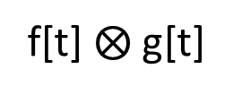
Time and “z” domains
Time domain
Z domain
Z-transform
f[t] = f₀, f₁, f₂, …
F(z)
g[t] =g₀, g₁, g₂, …
G(z)
Convolve
Multiply
Z-transform
f[t] $⨂$ g[t]
F(z)*G(z)
Notes:
If you want to convolve A with the sum of B and C, you can break it into two easier tasks. First convolve A with B, then A with C, then add the two results.
All linear functions are handy this way, they can always be broken down into parts, solved independently, then added back together.

Slide 43
But the Fourier transform is a special case of the z transform
Time domain
Z Frequency domain
Z-transform
Fourier transform
f[t] = f₀, f₁, f₂, …
FFT(f)
g[t]=g₀, g₁, g₂, …
FFT(g)
Convolve
Multiply
f[t] $⨂$ g[t]
FFT(f)*FFT(g)
Z-transform
Fourier transform
Notes:
If you want to convolve A with the sum of B and C, you can break it into two easier tasks. First convolve A with B, then A with C, then add the two results.
All linear functions are handy this way, they can always be broken down into parts, solved independently, then added back together.

Slide 44
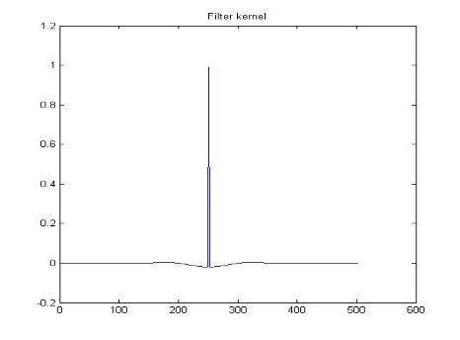
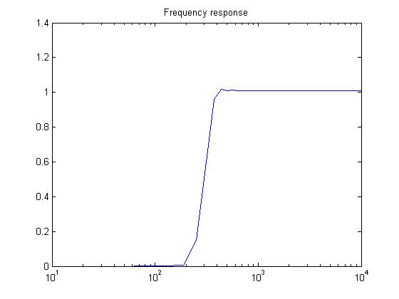
Time domain
Frequency domain
FFT
FFT
Convolve
Multiply
FFT
FFT(f)FFT(g)
Notes:
Not optimal

Slide 45
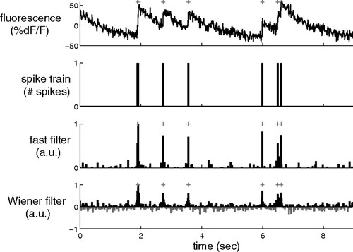
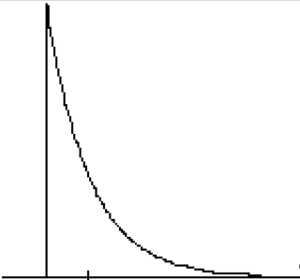


Application: “deconvolve” by dividing:
Calcium signals reflect spike trains (not directly observable) convolved with exponential decay. Need deconvolution to recover spike train.
$$⨂$$
(this can’t be observed directly)
$$+ noise=$$
(this is what you measure)
Notes:
Not optimal

Slide 46



Application: “deconvolve” by dividing:
Calcium signals reflect spike trains (not directly observable) convolved with exponential decay. Need deconvolution to recover spike train.
$$noise+$$
(this is what you measure)
$$Deconvolve:$$
$$Result:$$
(this can’t be observed directly)
Notes:
Not optimal

Slide 47
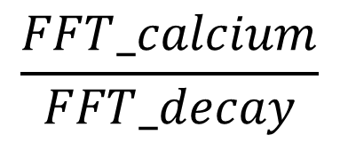

Time domain
Frequency domain
Calcium signal
FFT
FFT_calcium
$$noise+$$
Deconvolve
(hard)
Divide
(easy)
FFT
FFT_decay
FFT
$$\frac{FFT_calcium}{FFT_decay}$$
Spike train (not observable directly)
Notes:
Not optimal

Slide 48
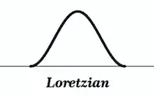
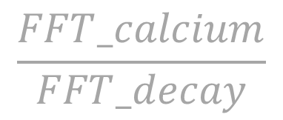
A problem …
Frequency domain
FFT_calcium
Might end up dividing by 0, or nearly 0
Divide
$$\frac{FFT_calcium}{FFT_decay}$$
Notes:
Not optimal

Slide 49
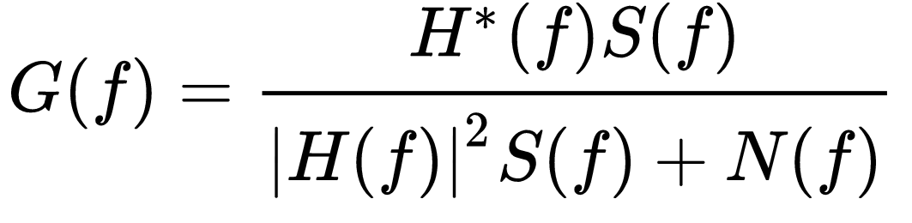
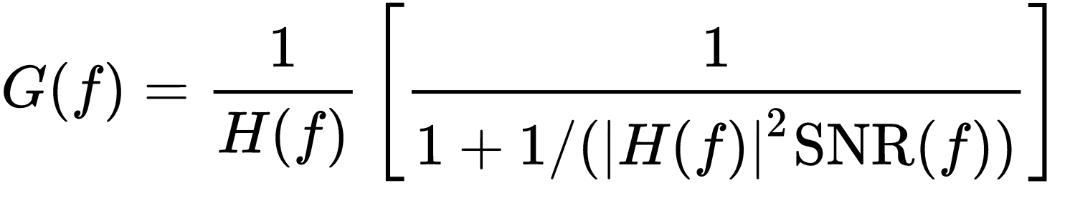
Weiner deconvolution
Notes:
Not optimal

Slide 50
Another application
In previous example, we used Matlab to design impulse response based on desired frequency response.
What if we have the opposite – we know the impulse response, but want to figure out the frequency reponse?

Slide 51
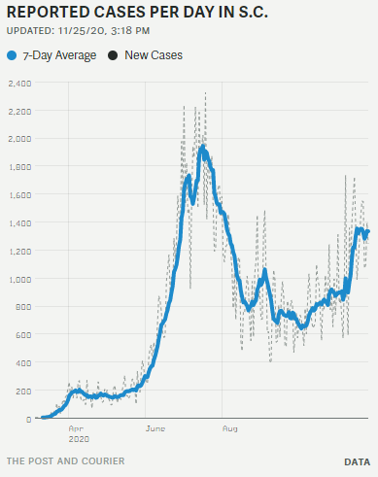
Example: a very common filter, 7-day moving average
Notes:
Not optimal

Slide 52
Moving average is convolution with “boxcar” function
Impulse response
Each value is 1/7 = 0.142857…
Notes:
Not optimal

Slide 53
Take FFT of “boxcar”…
Impulse response
Frequency response
= FFT of above pattern
Mostly low-pass.
“Ripples” at higher frequencies
Periodic “nulls” at frequencies 1/7, 2/7, 3/7, etc.
Frequency
Notes:
Not optimal

Slide 54
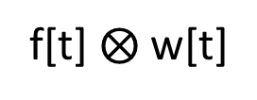
Moving average:
Time domain
Frequency domain
FFT
“f” = input waveform
FFT
“w” = Impulse function
Convolve
Multiply
FFT
f[t] $⨂$ w[t]
Notes:
Not optimal

Slide 55

Alternatives to boxcar.
Hamming window: $w\left(n\right)=0.54 −0.46 \cos{(\frac{2πn}{N−1})}$
Passband is about 2x wider than boxcar. But once the response comes down, it stays down.
Wider passband.
Smaller sidelobes

Slide 56


Can reverse where we do multiplication/convolution
Time domain
Frequency domain
FFT
f[t] = f₀, f₁, f₂, …
FFT(f)
g[t]=g₀, g₁, g₂, …
FFT(g)
Multiply
Convolve
f[t] $∗$ g[t]
FFT(f) $⨂$FFT(g)
FFT
Notes:
If you want to convolve A with the sum of B and C, you can break it into two easier tasks. First convolve A with B, then A with C, then add the two results.
All linear functions are handy this way, they can always be broken down into parts, solved independently, then added back together.

Slide 57

Sampling a continuous waveform = multiplication in time domain
Time domain
Frequency domain
-F/2
F/2
Impulse interval = 1/F
Impulse interval = F
Multiply
Convolve

Slide 58
Homework, due in two weeks (Dec 7, 2020)
Download the following two files to your MATLAB folder.
File #1 is a waveform plus “noise” around 2kHz.
https://www.dropbox.com/s/nvdwd3oeeifcqdb/Homework2.mat?dl=0
https://www.dropbox.com/s/ptwymcr8ynp5hir/Homework2.m?dl=0
File #2 is MATLAB code that loads file #1 and plays audio via speaker.
Task 1: write MATLAB code to remove the noise and identify the underlying musical piece. There should be at least two entirely different ways of removing the noise: one works in time domain, other in frequency domain
Task 2: Plot Fourier transforms of wave before and after filtering.

Slide 59
Good overview of filtering:
https://www.sciencedirect.com/science/article/pii/S0896627319301746

